Slide 1
Data Science Capstone Project Report
SpaceX Falcon 9 First Stage Landing Prediction
NGUYỄN THỊ HUYỀN
Coursera - IBM Data Science Professional Certificate
May 31, 2026
[Your Name Here] (Coursera - IBM Data Science Profe ssional Data Science Capstone Project Report

Slide 2
Introduction
Project Background:
Commercial space company SpaceX advertises Falcon 9 rocket launches at $62 million, significantly cheaper than competitors.
The cost savings are primarily due to SpaceX’s ability to reuse the first stage of the rocket.
Problem Statement:
Our goal is to predict whether the Falcon 9 first stage will land successfully. Accurately predicting this outcome helps estimate launch costs and provides valuable insights for competing companies.
GitHub Repository URL:
https://github.com/huyennt92/IBM-Data-Science-Capstone

Slide 3
Executive Summary
Methodology:
Data Collection: Utilized SpaceX REST API and Web Scraping from Wikipedia. Data Wrangling: Cleaned data, handled missing values, and applied One-Hot Encoding using Pandas.
EDA: Conducted Exploratory Data Analysis using SQL (DB2) and Visualization (Matplotlib/Seaborn).
Interactive Analytics: Built interactive maps with Folium and dashboards with Plotly Dash.
Predictive Analysis: Trained Logistic Regression, SVM, Decision Tree, and KNN models.
Key Results:
The Decision Tree model achieved the highest prediction accuracy on the test data. Payload mass and launch site are significant indicators of landing success.
[Your Name Here] (Coursera - IBM Data Science Profe ssional Data Science Capstone Project Report

Slide 4
Data Collection – SpaceX API
Process Overview:
Requested rocket launch data from the SpaceX REST API using requests.get().
Converted the JSON response into a Pandas DataFrame using json_normalize. Filtered data to include only Falcon 9 launches.
Replaced missing Payload Mass values with the calculated mean.
GitHub URL for API Notebook:
https://github.com/huyennt92/IBM-Data-Science-Capstone/blob/main/jupyter-labs-spacex-data-collection-api.ipynb

Slide 5
Data Collection – Web Scraping
Process Overview:
Requested historical Falcon 9 launch records from Wikipedia.
Parsed the HTML response using the BeautifulSoup library. Extracted column names from HTML table headers (<th>).
Iterated through table rows (<tr>) and cells (<td>) to construct a structured Pandas DataFrame.
GitHub URL for Web Scraping Notebook:
https://github.com/huyennt92/IBM-Data-Science-Capstone/blob/main/jupyter-labs-webscraping.ipynb
[Yor Name Here] (Coursera - IBM Data Science Profe ssional Data Science Capstone Project Report

Slide 6
Data Wrangling Methodology
Cleaning and Processing:
Calculated the number of successful and failed landings based on the Outcome
column.
Created a new binary target variable Class (1 = Success, 0 = Failure).
Applied One-Hot Encoding using pd.get_dummies() on categorical variables such as Orbit, LaunchSite, LandingPad, and Serial.
Cast all numerical features to float64 to prepare for Machine Learning models.
GitHub URL for Data Wrangling Notebook:
https://github.com/huyennt92/IBM-Data-Science-Capstone/blob/main/labs-jupyter-spacex-Data%20wrangling.ipynb

Slide 7
EDA with Data Visualization
Charts Used and Their Purpose:
Scatter Plots: Used to visualize the relationship between Flight Number vs. Launch Site and Payload Mass vs. Launch Site, colored by landing class.
Bar Charts: Used to display the success rate across different Orbit types.
Line Charts: Used to track the success rate over the years (annual trends).
GitHub URL for EDA Visualization Notebook:
https://github.com/huyennt92/IBM-Data-Science-Capstone/blob/main/jupyter-labs-eda-sql-coursera_sqllite.ipynb
[Your Name Here] (Coursera - IBM Data Science Profe ssional Data Science Capstone Project Report

Slide 8
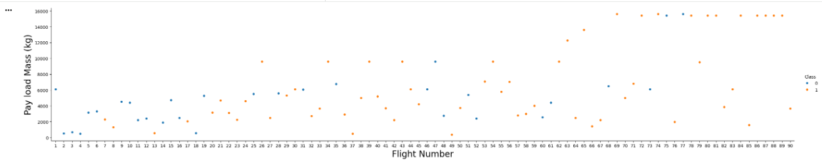
EDA Visualization Results 1

Slide 9
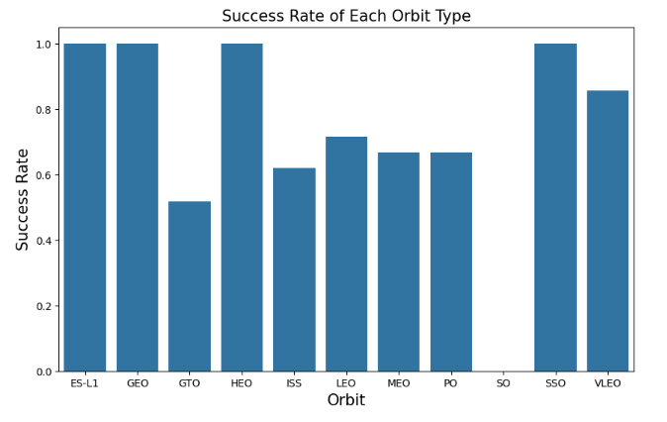
EDA Visualization Results 2
[Your Name Here] (Coursera - IBM Data Science Profe ssional Data Science Capstone Project Report

Slide 10
EDA with SQL
SQL Queries Performed:
Queried unique Launch Sites from the database.
Calculated total Payload Mass carried by boosters.
Counted successful landings at specific sites (e.g., CCAFS).
Retrieved records of specific mission outcomes based on payload mass ranges.
Ranked launch sites by successful landing counts using GROUP BY and ORDER BY.
Performed time analysis to observe successful landing trends over specific months/years
GitHub URL for SQL Notebook:
https://github.com/huyennt92/IBM-Data-Science-Capstone/blob/main/jupyter-labs-eda-sql-coursera_sqllite.ipynb
[Your Name Here] (Coursera - IBM Data Science Profe ssional Data Science Capstone Project Report

Slide 11
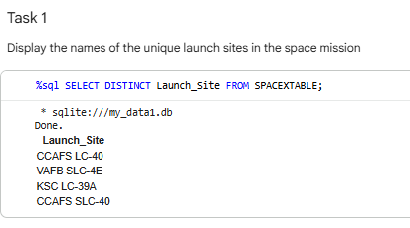
EDA with SQL Results

Slide 12
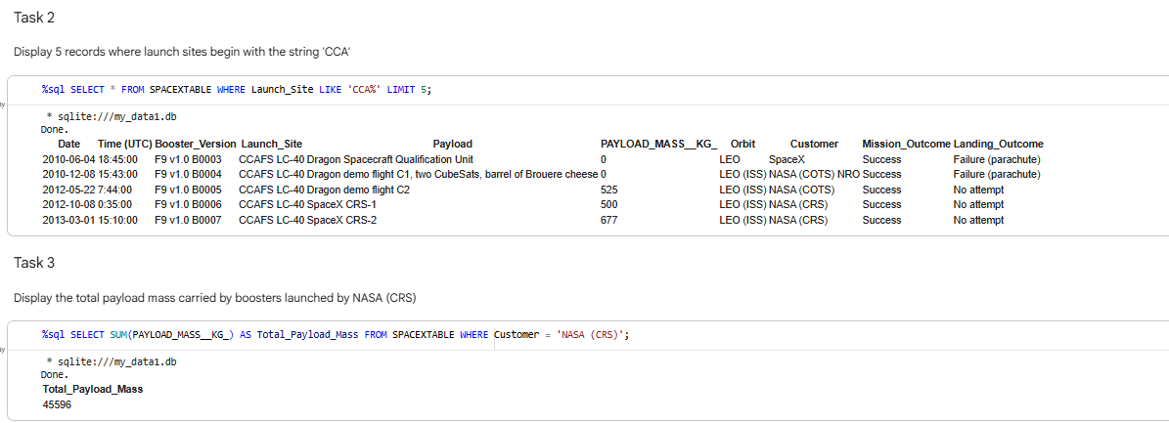
EDA with SQL Results

Slide 13
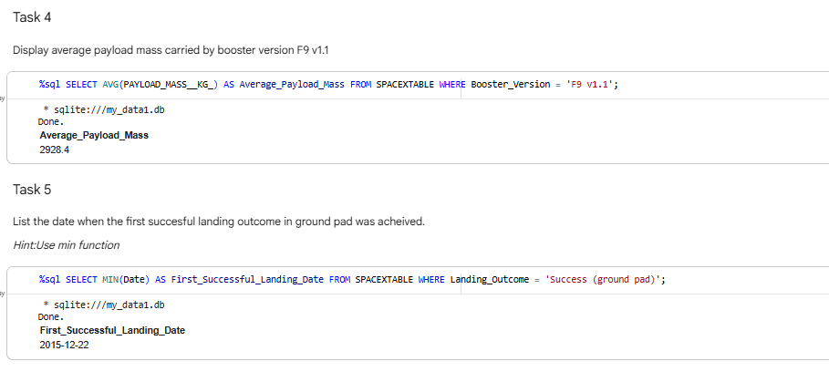
EDA with SQL Results

Slide 14
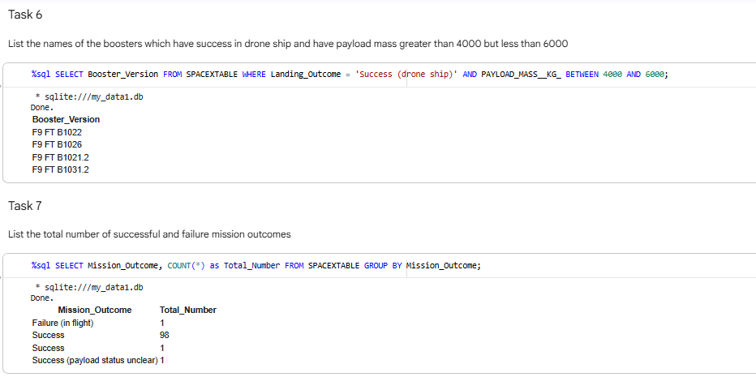
EDA with SQL Results

Slide 15
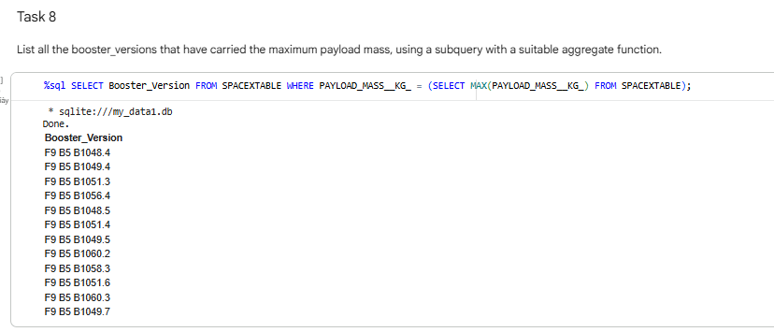
EDA with SQL Results

Slide 16
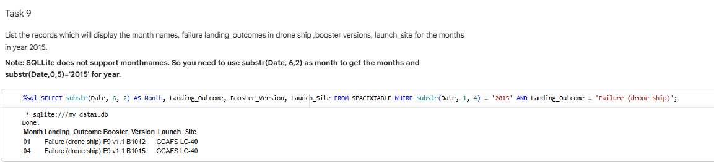
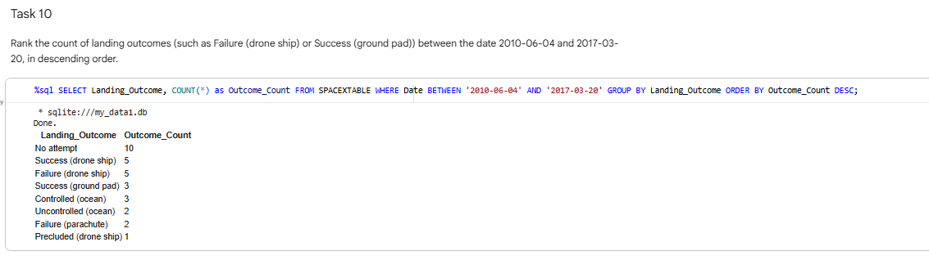
EDA with SQL Results

Slide 17
Interactive Visual Analytics
Folium Map:
Plotted Launch Sites on an interactive map.
Added Marker Clusters to differentiate successful (green) and failed (red) launches.
Performed proximity analysis by calculating distances to railways, highways, and coastlines.
Plotly Dash App:
Built a web dashboard with dropdowns and range sliders.
Created interactive Pie Charts for success rates by site.
Created Scatter Plots for Payload Mass vs. Outcome.
GitHub URLs: https://github.com/huyennt92/IBM-Data-Science-Capstone/blob/main/lab_jupyter_launch_site_location.ipynb
[Your Name Here] (Coursera - IBM Data Science Profe ssional Data Science Capstone Project Report

Slide 18
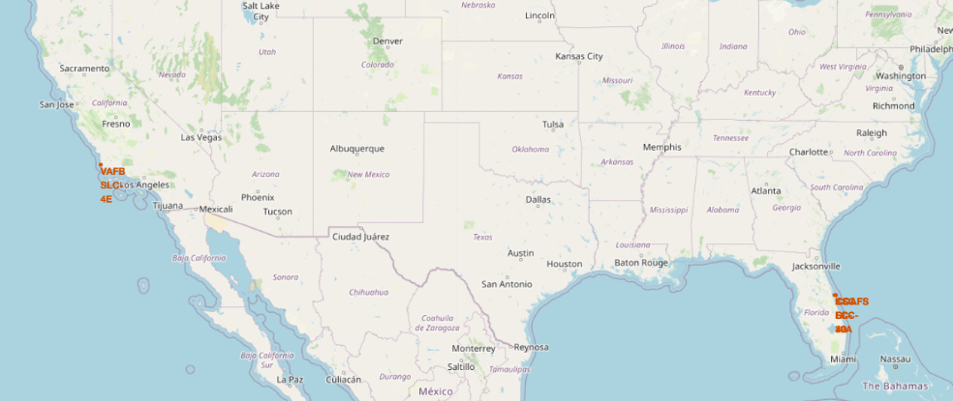
Folium Map Results

Slide 19
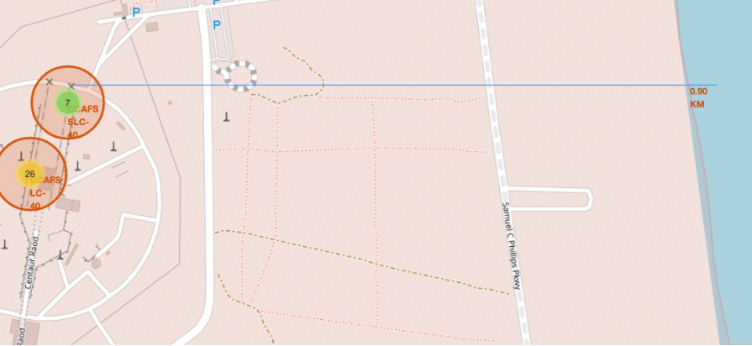
Folium Map Results

Slide 20
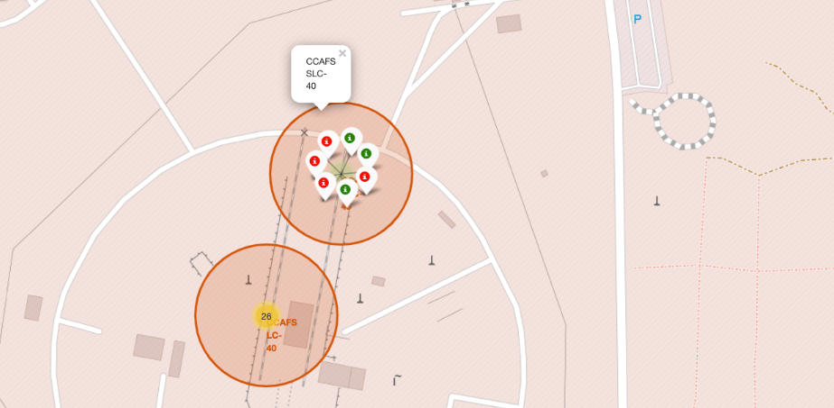
Plotly Dash Results

Slide 21
Predictive Analysis
Model Evaluation & Conclusion:
Models Tested: Logistic Regression, Support Vector Machine (SVM), Decision Tree, and K-Nearest Neighbors (KNN).
Best Model: All models performed similarly well on the test data (approx. 83.3% accuracy), but the Decision Tree (or SVM) is preferred for its specific hyperparameter tuning results.

Slide 22
Predictive Analysis

